Slide 1


Fake job detection
Foundation of Artificial Intelligence and Data Science
Vijayakumaran S (21ADR061)
Rohith S J (21ADR040)
Rishi Raghav G (21ADR038)
Vibeesh N (21ADR059)
Vignesh T (21ADR060)
Department of AI
Kongu Engineering College, Perundurai
Ms. D. Sathya

Slide 2
Outline
Labor fraud is on the rise. The number of job scams are doubled in 2018 when compared to 2017, according to CNBC.
This is a dangerous problem and can be addressed by machine learning and natural language processing (NLP) techniques.
This project follows five stages. The five stages adopted for this project are –
1. Problem Definition (Project Overview, Project statement and Metrics)
2.Data Collection
3.Data cleaning, exploring and pre-processing
4.Modeling
5.Evaluating

Slide 3
Problem Statement
Meanwhile, job advertisements became popular on the Internet, making it easy for job seekers to find jobs.
However, there are also some fake job listings for them on the internet, all of which are posted by scammers. Scammer offers job seeker a very lucrative job opportunity and he later claims their money in promise of job.
So we are going to predict the job posts are real or fake using machine learning.

Slide 4
Objectives
The main objective of this is identifying the fake job recruitment by detecting it. To avoid fraudulent post for job in the internet.
This project aims to create a classifier that will have the capability to identify fake and real jobs.
And to identify the scammers.

Slide 5
Introduction
In covid pandemic period many people has lost the job.
They tried for new job in online through job available posts but many of the post are fake or it is posted by scammers.
At first the scammers get job seekers money in hand of job promise.
So we are going to predict the job posts are real or fake using machine learning

Slide 6
Literature Survey
The Random forest ensemble classifier model :
PROS : The Random forest ensemble classifier was utilized as the classification algorithm, and it was built using a collection of tree structured Classifiers.
CONS : Considering the fraud detecting problem, the situation of not detecting the job as fraud (low sensitivity) could be threatening for jobseekers

Slide 7
Naïve Bayes :
Naïve Bayes is the baseline model, and it is used because it can compute the conditional probabilities of occurrence of two events based on the probabilities of occurrence of each individual event, encoding those probabilities is extremely useful.
SGD :
SGD Classifier is used since it implements a plain stochastic gradient descent learning routine which supports different loss functions and penalties for classification.

Slide 8
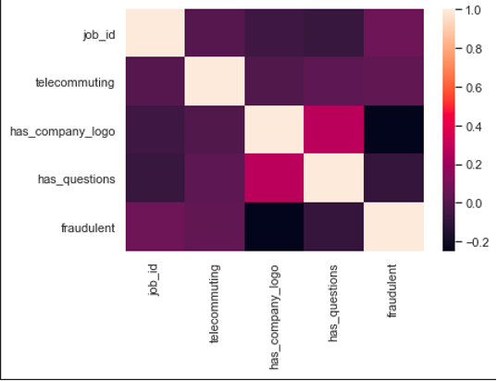
Methodology
First step is to visualize the dataset in this project is to create a correlation matrix to study the relationship between the numeric data.
The correlation matrix does not exhibit any strong positive or negative correlations between the numeric data.

Slide 9
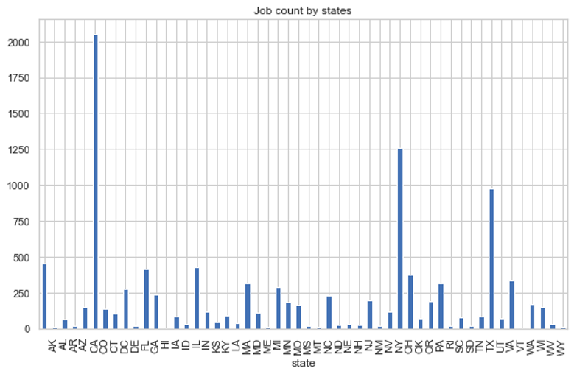
However, an interesting trend was noted with respect to the Boolean variable telecommuting. In cases when both this variable had value equal to zero there is a 92% chance that the job will be fraudulent. After the numeric features the textual features of this dataset is explored. We start this exploration from location.
California, New York and Texas have the highest number of job postings

Slide 10
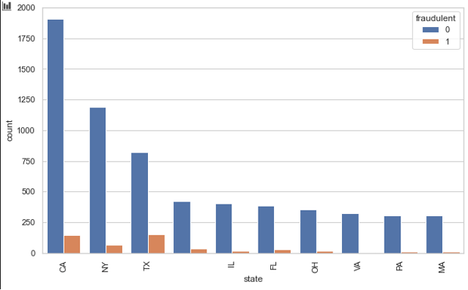
This barchart shows the distribution of fake and real jobs in the top 10 states.
The graph above shows that Texas and California have a higher possibility of fake jobs as compared to other states.
Now we are going to plot ratio of fake,

Slide 11
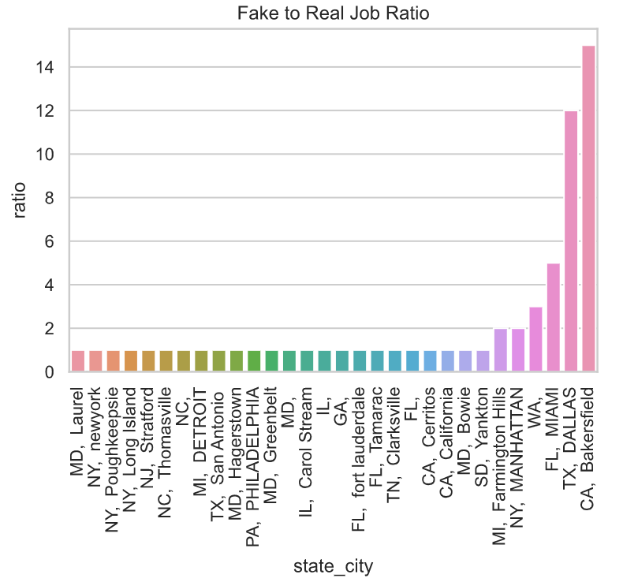
The California has highest fake job ratio 15:1 and Texas has 12:1.
Any job postings from these locations will certainly have a high chance of being fraudulent

Slide 12
Algorithms
The algorithms and techniques used in project are:
Natural Language Processing
Naïve Bayes Algorithm
SGD Classifier
Random Forest
The accuracy and F1 values ​​of Naive Bayes and SGD classifiers are compared to select the final model. Naïve Bayes is the base model and is used because it can calculate the conditional probability that two events will occur based on the probability that each individual event will occur.
The SGD classifier is used to implement a simple stochastic gradient descent training routine that supports different classification loss functions and penalties.

Slide 13
Performance Evaluation
The final model used for this analysis is SGD. The baseline model and SGD results are shown in the table below.
According to metrics the SGD model has greater performance than baseline model.
Model | Accuracy | F1-score
Naïve Bayes(baseline model) | 0.971 | 0.743
SGD | 0.975 | 0.79
Random Forest | 0.974 | 0.76

Slide 14
Conclusion
Job fraud detection ensures job seekers only to receive legitimate offers from companies.
Several machine learning techniques have been proposed for detecting employment fraud.
Our model SGD is best suited for classifying fake job post and the scammers.
It has an accuracy 97%, so it can classify and detect whether the posted job is real or fake.

Slide 15
References
https://scikit-learn.org/stable/modules/naive_bayes.html
https://www.javatpoint.com/machine-learning-naive-bayes-classifier
https://www.tutorialspoint.com/scikit_learn/scikit_learn_stochastic_gradient_descent.htm#:~:text=Stochastic%20Gradient%20Descent%20(SGD)%20is,as%20SVM%20and%20Logistic%20regression.
https://www.tutorialspoint.com/scikit_learn/scikit_learn_stochastic_gradient_descent.htm#:~:text=Stochastic%20Gradient%20Descent%20(SGD)%20is,as%20SVM%20and%20Logistic%20regression.
https://www.tutorialspoint.com/scikit_learn/scikit_learn_stochastic_gradient_descent.htm#:~:text=Stochastic%20Gradient%20Descent%20(SGD)%20is,as%20SVM%20and%20Logistic%20regression.
https://www.section.io/engineering-education/sgd-classifier/
https://www.javatpoint.com/machine-learning-random-forest-algorithm

